Slide 1

Fisheries Regulations App
Digitising the Fisheries management Chart

Slide 2

Outline
Introduction
Fisheries Informatics team and project
Previous outputs
Fisheries Management App
Aims
Proposed elements and scope
Main elements/decisions re app – feedback request
Discussion/Q&A

Slide 3
Fisheries Informatics Project
MI based project aiming to visualize existing data, increase its usage/utility and make it more easily accessible.
Team; Compass Informatics contractors with MI staff (Colm Lordan and David Currie)
Outputs;
Species Dashboard
Digital Stockbook
IGFS data explorer
Cod tagging data portal (in development)
R developers; statistical and biological/environmental background

Slide 4
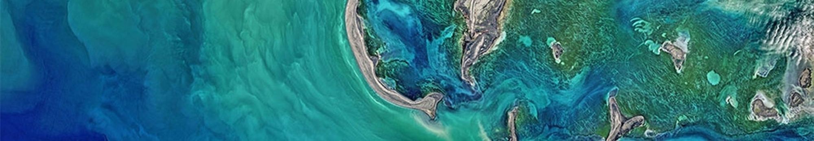
Shiny Web apps
Species Dashboard
Digital Stockbook
IGFS Data Explorer
The Species Dashboard is a web application that makes biological fisheries data more available to all interested parties. In particular, it allows people to explore the length, weight, and age data of commercial species that are caught around Ireland and allows the effects of factors such as year, sex, area, and gear on the fish to be investigated.
The Stock Book provides the latest scientific advice that informs fishing opportunities for the following year. The Digital Stock Book app makes this advice available on-line in an interactive way – for example it includes a forecasting tool that allows users to see the projected impact of different fishing scenarios.
The IGFS is part of an internationally coordinated series of demersal trawl surveys that provides data on fish stocks that are not available from sampling commercial fishing trips. The IGFS app allows users to explore the results of the survey using a number of tools.

Slide 5
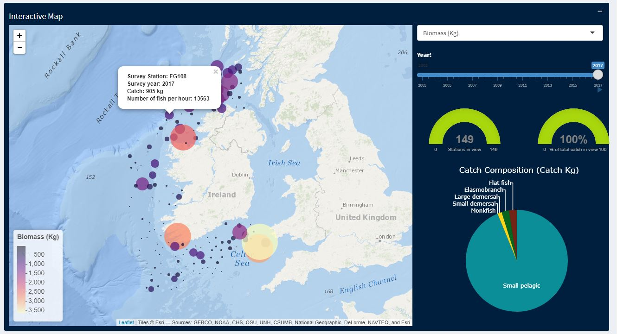
IGFS Data Explorer

Slide 6
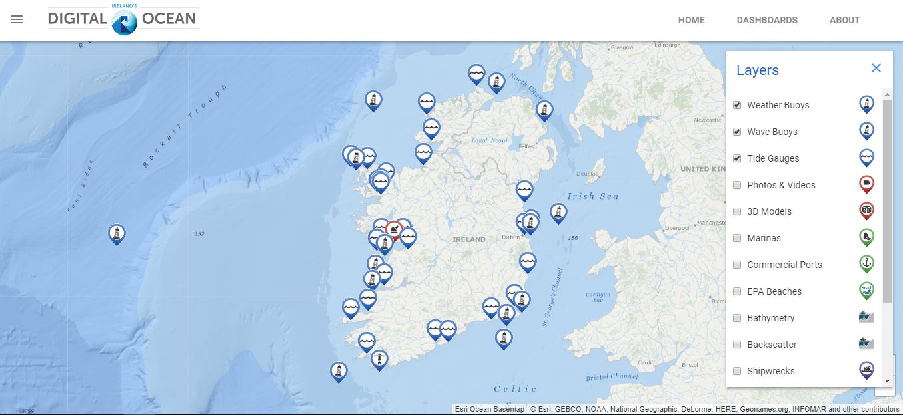
Digital Ocean

Slide 7
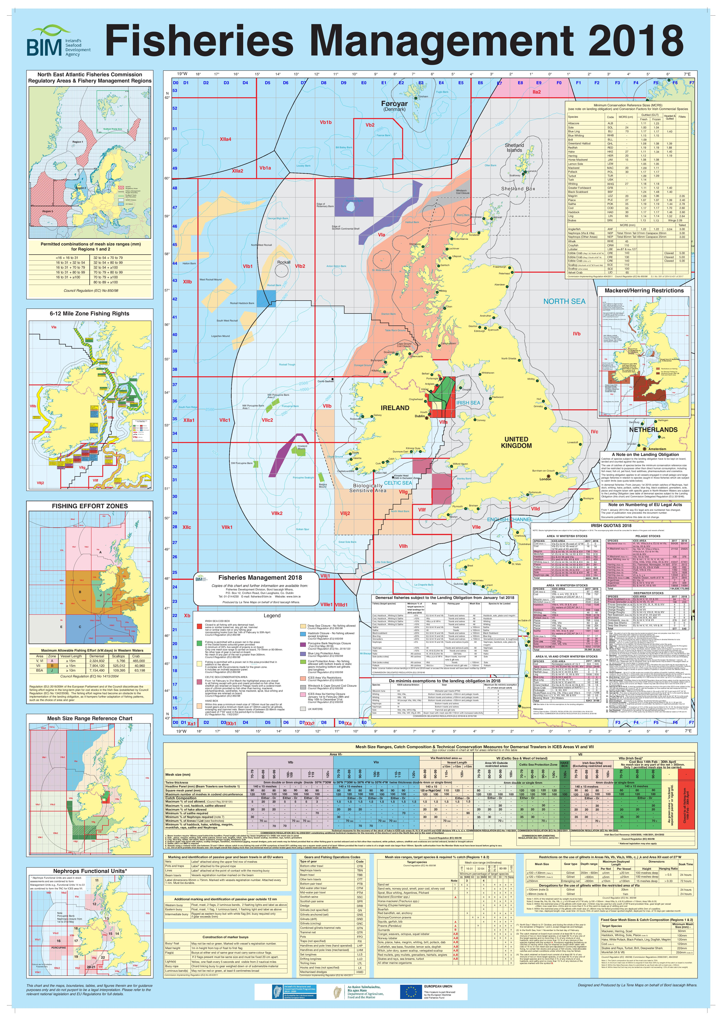
TCM regulations app
Aims
Produce a public facing map-based application that will give user-friendly access to information on Technical Conservation Measures (TCMs)
Deliver a digital version of the key features of the BIM Fisheries Managements Chart - linking to the most current and up to date fisheries regulations
Users (primarily fishermen but also other stakeholders) should be able to easily and quickly inform themselves of regulations and policies related to the TCMs in a geographical area

Slide 8
Timeline
Initial scope
Phased approach
Map-based tool showing area closures etc.
Mesh size guidelines
Reference tables; gear codes, passive gear marking etc.
Desktop based
Offline
Beta version – February 2019 testing; volunteers/interested
Feedback sessions after beta release
Increased functionality for v1 release- August 2019
Offshore initially with possibility of inshore version at a later date

Slide 9
Development prioritisation
Priorities
Practical priorities for fishermen
Map-based tool
Desktop based
Offline
Data publication tool
Will need to be updated frequently (manually?) – monthly quotas
Links to SFPA regulations
Offshore primarily
Primarily Non-personalised interactions (which filters most useful?)
Filters?
Vessel length?
Target species
What is most important to actual users?
Is it a problem to have to update regularily (manually) to ensure most recent advice/quotas etc
Offline vs online
Desktop/mobile? What platform most useful
Any other information of how this can be tailored to be most useful and easy to use
9

Slide 10

THANK YOU

